Slide 1



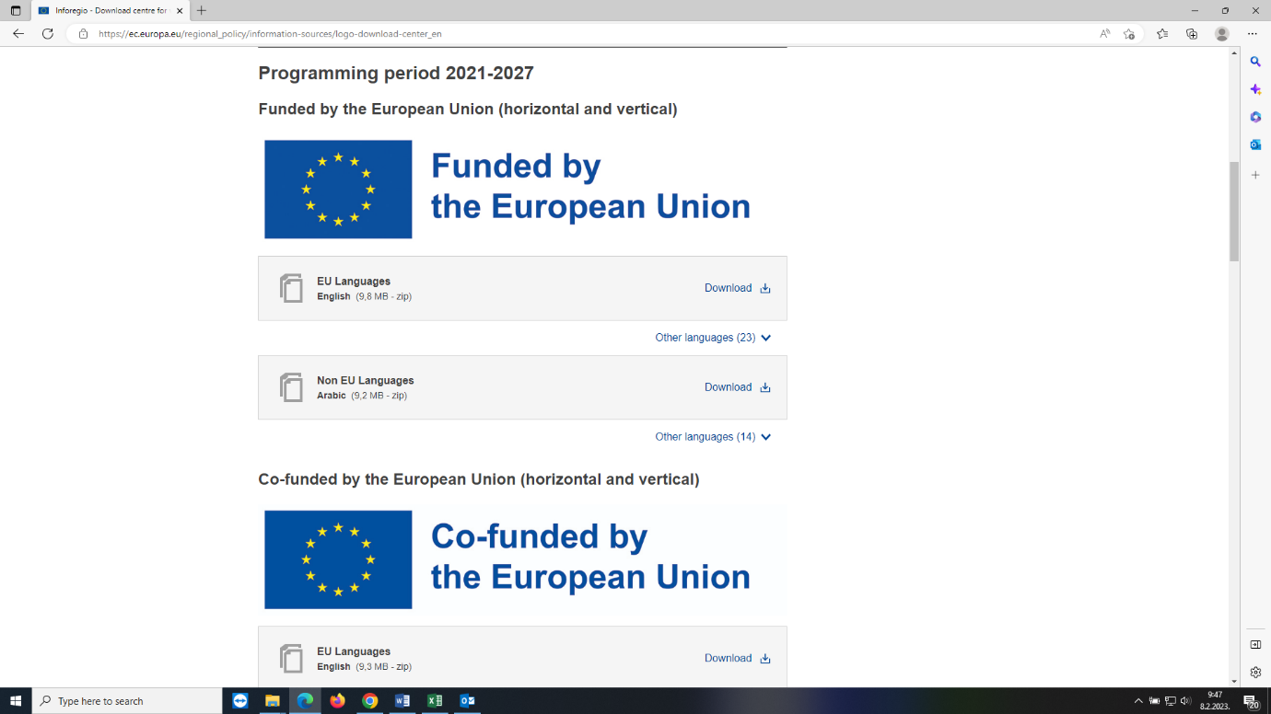



Twinning light project: Improving and strengthening administrative capacity of the Audit Authority for audit of IPARD III programme and preparation for future certification work for EAGF and EAFRD
CLOSING EVENT
Twinning light project: Improving and strengthening administrative capacity of the Audit Authority for
audit of IPARD III programme and preparation for future certification work for EAGF and EAFRD
(ME 22 IPA FI 02 25 TWL)
Podgorica, 27 April 2026

Slide 2
Twinning light project: Improving and strengthening administrative capacity of the Audit Authority for
audit of IPARD III programme and preparation for future certification work for EAGF and EAFRD
OVERALL OBJECTIVE OF THE PROJECT
The overall objective is to prepare Montenegro for sound financial management of the IPARD III programme and, after accession, of the agricultural funds EAGF and EAFRD in line with EU requirements; which will at the same time contribute to fulfilment of obligations from Negotiation chapters 11 Agriculture and rural development, 22 Regional Policy and Coordination of Structural Instruments as well as chapter 32 Financial Control.

Slide 3
Twinning light project: Improving and strengthening administrative capacity of the Audit Authority for
audit of IPARD III programme and preparation for future certification work for EAGF and EAFRD
SPECIFIC OBJECTIVE OF THE PROJECT
The project specific objective is to assist Audit Authority of Montenegro, in strengthening of institutional and administrative capacities for efficient and effective audit of IPARD III programme and preparation for the future certification work for EAGF and EAFRD as Certification Body, through comprehensive trainings (presentations, on the job trainings, internships and study visits) and round off of procedures.

Slide 4
Twinning light project: Improving and strengthening administrative capacity of the Audit Authority for
audit of IPARD III programme and preparation for future certification work for EAGF and EAFRD
RESULTS OF THE PROJECT

Slide 5
Twinning light project: Improving and strengthening administrative capacity of the Audit Authority for
audit of IPARD III programme and preparation for future certification work for EAGF and EAFRD
PROJECT IN NUMBERS
Total budget: 200.000,- EUR
Number of expert days: 124
Number of weeks: 10
Number of missions: 31
Total number of experts: 14 + Project Leader
Number of MS: 2
Implementation period: 8 months

Slide 6
Twinning light project: Improving and strengthening administrative capacity of the Audit Authority for
audit of IPARD III programme and preparation for future certification work for EAGF and EAFRD
PROJECT IN NUMBERS (2)
Components: 2
Results: 5
Activities: 15
Internships: 3
Study visits: 2
Side letters: 0
Addendum: 0

Slide 7
Twinning light project: Improving and strengthening administrative capacity of the Audit Authority for
audit of IPARD III programme and preparation for future certification work for EAGF and EAFRD
COMPONENTS OF THE PROJECT
Component 1: Strengthening the capacity of Audit Authority for audit of Measures 7 and 9, on IT security as well as increase knowledge on IACS and PRAG rules
Component 2: Development of relevant procedures for IPARD III and strengthening the capacity of Audit Authority for audit of IPARD III programme.

Slide 8
Twinning light project: Improving and strengthening administrative capacity of the Audit Authority for
audit of IPARD III programme and preparation for future certification work for EAGF and EAFRD
RESULTS PER COMPONENT
Component 1
Result 1: Audit Authority staff trained on audit of measure 7 Farm diversification and business development and Measure 9 Technical assistance.
Training Programme and training materials regarding audit of measures 7 and 9 were prepared
Draft of checklist for auditing Measure 7 and Measure 9 were developed
On-the-job training for at least 7 staff members of the Department was conducted
Two study visits were organized (in September 2025 in Croatia and in April 2026 in Austria)

Slide 9
Twinning light project: Improving and strengthening administrative capacity of the Audit Authority for
audit of IPARD III programme and preparation for future certification work for EAGF and EAFRD
RESULTS PER COMPONENT
Component 1
Result 2: Increased level of knowledge on IT security/ digitalisation used / needed in the IPARD entities/ future Member state authorities (auditees) relevant for the current tasks and updated AA checklists according to ISO 27002 standard
On-the-job trainings for at least 7 staff members of the Department related to IT security measures was conducted
Checklists and working papers for audit of Information security system were developed
New developed documents related to Information security system were presented

Slide 10
Twinning light project: Improving and strengthening administrative capacity of the Audit Authority for
audit of IPARD III programme and preparation for future certification work for EAGF and EAFRD
RESULTS PER COMPONENT
Component 1
Result 3: Comprehensive trainings on IACS and PRAG rules and development of procedures, checklists and working papers related to audit of IACS measures as well as according to PRAG rules
On-the-job trainings for at least 7 staff members of the Department related to IACS and IACS elements and databases was conducted
On-the-job trainings for at least 7 staff members of the Department related to PRAG procedures as obligatory for measures 6 and 9 was conducted
Procedures, checklists and working papers related to audit of IACS measures as well as according to PRAG rules were developed

Slide 11
Twinning light project: Improving and strengthening administrative capacity of the Audit Authority for
audit of IPARD III programme and preparation for future certification work for EAGF and EAFRD
RESULTS PER COMPONENT
Component 2
Result 4: Revised Audit Manual in line with requirements for the audit of IPARD III Programme
Analysis of relevant requirements regarding regulations and audit requirements for IPARD III programming period 2021-2027 were developed
Audit Manual for IPARD with supporting checklist and working papers were updated/developed
New/updated audit manual was presented to AA staff

Slide 12
Twinning light project: Improving and strengthening administrative capacity of the Audit Authority for
audit of IPARD III programme and preparation for future certification work for EAGF and EAFRD
RESULTS PER COMPONENT
Component 2
Result 5: AA staff trained on audit of the IPARD III programme as a basic preparation for audit of EAGF and EAFRD, with focus on new requirements, new measures (especially 4 and 6)
Training needs analysis and training programme were developed
On-the-job trainings regarding the programming period 2021-2027 (IPARD III) with specific focus on new requirements, new measures (especially 4 and 6) for staff members of the Department was conducted
Three internships were conducted (2 in Croatia in September 2025 and one in Austria in April 2026)

Slide 13
Twinning light project: Improving and strengthening administrative capacity of the Audit Authority for
audit of IPARD III programme and preparation for future certification work for EAGF and EAFRD
STUDY VISITS
Croatia – 22 -26 September 2025
  Zagreb and Istria
  5 working days
  7 participants
  On the spot
Austria – 20 – 24 April 2026
  Wien
  5 working days
  7 participants
  On the spot

Slide 14
Twinning light project: Improving and strengthening administrative capacity of the Audit Authority for
audit of IPARD III programme and preparation for future certification work for EAGF and EAFRD
INTERNSHIPS
Two in Croatia – 22 September – 3 October 2025
  Zagreb and Istria
  10 working days
  On the spot
Austria – 13 – 24 April 2026
  Wien
  10 working days
  On the spot

Slide 15
Twinning light project: Improving and strengthening administrative capacity of the Audit Authority for
audit of IPARD III programme and preparation for future certification work for EAGF and EAFRD
INFORMATION ON THE EXECUTION OF VISIBILITY AND PUBLICITY MEASURES
Important requirement from EU
Raising awareness of this twinning light project but also of twinning projects in general
Opening ceremony held on 6 November 2025;
Closing ceremony 27 April 2026;
News on the Project Opening/Closing published on ARPA website;
Leaflets produced with key information on the Project;

Slide 16
Twinning light project: Improving and strengthening administrative capacity of the Audit Authority for
audit of IPARD III programme and preparation for future certification work for EAGF and EAFRD
Thank you for your attention
neven.sprlje@arpa.hr

